Slide 1
CSE 2451 Introduction
Tong Liang

Slide 2
Overview
Course information
Brief History of C
Motivation
Characteristics of C
Hello world example
Building a program
Standards of C

Slide 3
Course Information
Syllabus for autumn 2022 is on Carmen
Instructor: Tong Liang
Email: liang.693@osu.edu
Tentative office hours:
Tuesday 2pm - 3pm (in-person)
Wednesday 3pm – 4pm (online)
Office hour location: BE406
First week attendance

Slide 4
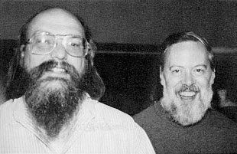
Brief History of C
Ken Thompson and Dennis Ritchie
Long time colleagues
Turing Award in 1983 for their development of generic operating systems theory and specifically for the implementation of the UNIX operating system
Invented in early 1970’s at Bell Labs
Standardized by American National Standards Institute in 1989 as C89, also known as ANSI C
Most recent standards C17
Ken Thompson,
Invented B programming language, a direct predecessor of C programming language
Dennis Ritchie, created C programming language

Slide 5
Why C?
Performance
Strict resource constraints
Limited memory
Hard real time systems: no tolerance to any missing deadlines, e.g.:
Nuclear facility
Aircraft control
Rocket control
Lots of irreplaceable software were written in C
Linux kernels
Apache
OpenSSL
Python, Ruby, PHP, Perl interpreters (interpreted language)
Basis for learning C-like languages (C++, Java, C#)

Slide 6
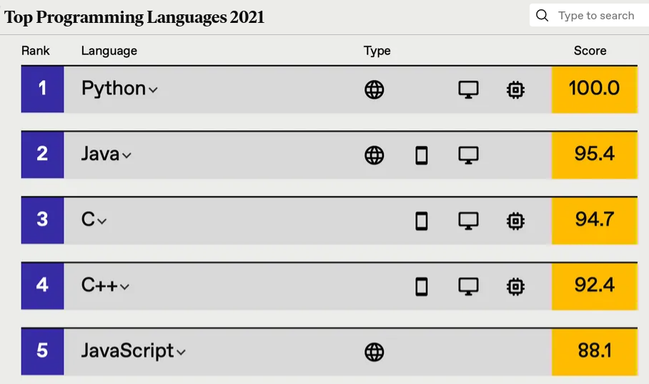
IEEE Spectrum Annual Interactive Rankings
https://spectrum.ieee.org/top-programming-languages-2021

Slide 7
Characteristics of C
Procedural language (vs object-oriented language)
Free-form language:
the position of characters on the page in programming text is insignificant
Spaces and horizontal tabs can be used freely to layout the source code if they don’t break keywords, operators, and identifiers
Example of non-free-form language: Python, spaces/tabs carry syntactic meaning
No garbage collection (manual memory management)
Direct memory access
Compiled language (vs interpreted language)
C can run on bare machine/metal
a computer executing instructions directly on logic hardware without an intervening operating system
e.g., embedded system or firmware without system software layer

Slide 8
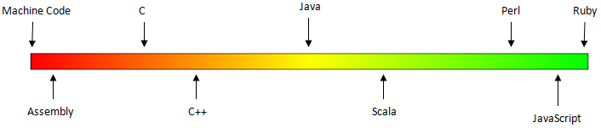
Mid-to-low level language
Compared to assembly language
Abstracts the hardware view (registers, memory, call stacks)
Provides variables, functions, arrays, complex arithmetic, Boolean expressions
Compared to other high-level language
Maps almost directly into hardware instructions
Provides a minimal set of abstractions compared to other high-level languages

Slide 9
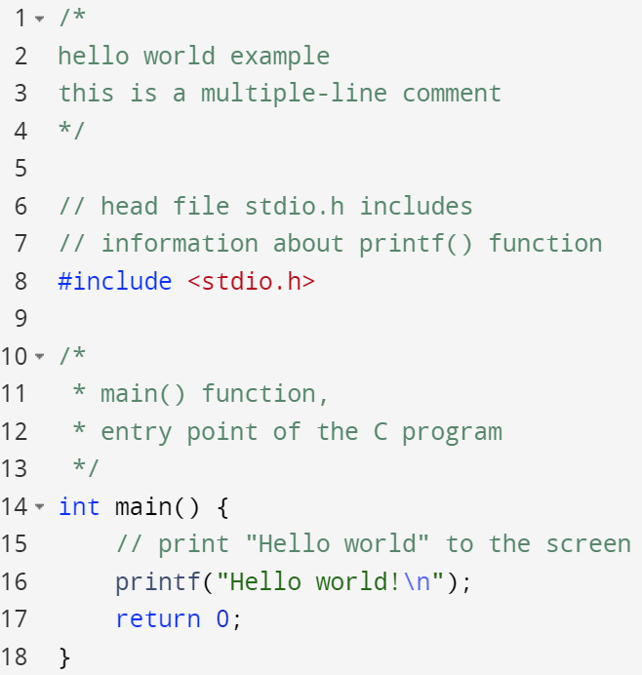
Hello World Example
Two types of comments
One-line comment written after //
Multiple-line comment written between /* and */
Header files:
Include information of pre-defined functions
C offers a set of standard C library functions
main() function is the entry point of a C program
A C program always starts from its main() function
There’s only one main() function in the entire C program

Slide 10
Build a Program
Compiling
the process of turning source code into object code
Linking
The process of combining object code with libraries into an executable program
Building
The process composed of compiling and linking
source code
Preprocessor
compiling
expanded code
Compiler
assembly code
building
Assembler
other object files
object code
libraries
linking
Linker
executable program

Slide 11
Build a Program - commands
Use compilers: gcc, clang, etc
Common compiling tool also does the link job for you
Compile source code into an executable program
Navigate terminal to the directory storing the source code
Run the compiling command:
Runs the resulted executable program file:
gcc hello.c –o myprogram
./myprogram

Slide 12
Build a Program – break down of building process
Preprocessing
copy header file’s code
expand inline macros
delete all comments
gcc –E hello.c –o hello_exp.c
=> hello_exp.c (expanded code)
source code
Preprocessor
Compiling
Semantic analysis
Check errors
Optimization (e.g., remove dead code)
gcc –S hello_exp.c
expanded code
compiling
=> hello_exp.s (assembly code)
Compiler
assembly code
building
Assembler
Assembling
Converts to object file (the machine code / binary)
gcc –c hello_exp.s
other object files
object code
libraries
=> hello_exp.o (object code)
linking
Linker
Linking
Link to other object files
Link libraries
gcc hello_exp.o –o myprogram
executable program
=> myprogram (executable program)

Slide 13
Multi-File Program
Source code can be divided into multiple source files
Change on one source file requires compiling of that specific file instead of all source files -> faster to update your program
source code A
source code B
source code C
Preprocessor
Preprocessor
Preprocessor
compiling
expanded code A
expanded code B
expanded code C
Compiler
Compiler
Compiler
assembly code A
assembly code B
assembly code C
building
Assembler
Assembler
Assembler
object code A
object code B
object code C
linking
Linker
libraries
executable program

Slide 14
Standards of C Programming Language
C standard describes the syntax, semantics and execution environment of the language and its associated libraries
To define the nature and behavior of programs written in C
To allow programs to be written on one computer system and moved to another and works properly on both systems
C standards leaves some behavior of C as undefined and unspecified to simplify the specification and allow some flexibility in implementation (compiler, linker, standard library supported by the compiler)
Size of variables are not uniformly fixed across all platforms
Optimization happening in the compiling process (different compilers may use different optimization strategy)
Conformance of C
If a syntax/semantics rule is conforming, it’s behavior is defined across all platforms/compilers
If a syntax/semantics rule is not conforming, it’s behavior is unspecified -> meaning the same source code may lead to different programs if you use different implementations of C (building the program with different tools (gcc vs clang))
Standard and Compiler for this course
Standard: C99
Compiler: gcc
Collection of C/C++ standards documentations
https://stackoverflow.com/a/83763/7570599

